Slide 1

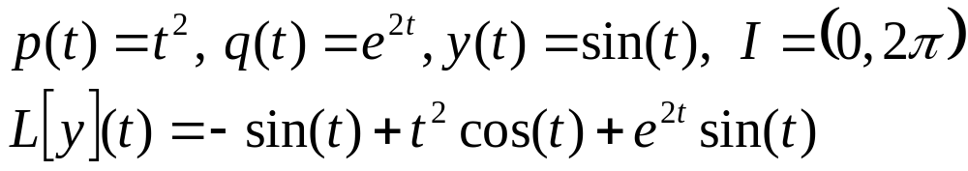
Ch 3.2: Solutions of Linear Homogeneous Equations; Wronskian
Let p, q be continuous functions on an interval I = (α, β), which could be infinite. For any function y that is twice differentiable on I, define the differential operator L by
Note that L[y] is a function on I, with output value
For example,

Slide 2
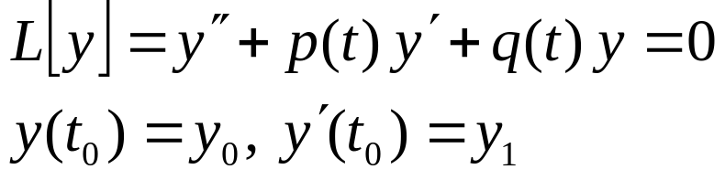
Differential Operator Notation
In this section we will discuss the second order linear homogeneous equation L[y](t) = 0, along with initial conditions as indicated below:
We would like to know if there are solutions to this initial value problem, and if so, are they unique.
Also, we would like to know what can be said about the form and structure of solutions that might be helpful in finding solutions to particular problems.
These questions are addressed in the theorems of this section.

Slide 3
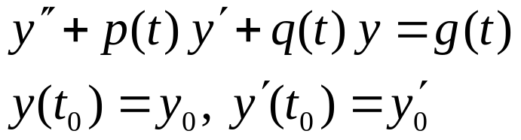
Theorem 3.2.1
Consider the initial value problem
where p, q, and g are continuous on an open interval I that contains t₀. Then there exists a unique solution y = φ(t) on I.
Note: While this theorem says that a solution to the initial value problem above exists, it is often not possible to write down a useful expression for the solution. This is a major difference between first and second order linear equations.

Slide 4
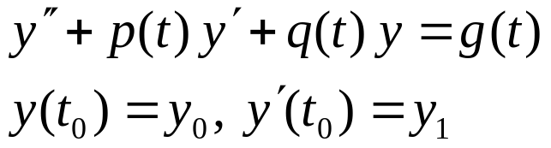

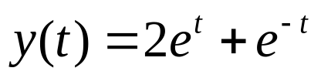
Example 1
Consider the second order linear initial value problem
In Section 3.1, we showed that this initial value problem had the following solution:
Note that p(t) = 0, q(t) = -1, g(t) = 0 are each continuous on (-∞, ∞), and the solution y is defined and twice differentiable on (-∞, ∞).

Slide 5
Example 2
Consider the second order linear initial value problem
where p, q are continuous on an open interval I containing t₀.
In light of the initial conditions, note that y = 0 is a solution to this homogeneous initial value problem.
Since the hypotheses of Theorem 3.2.1 are satisfied, it follows that y = 0 is the only solution of this problem.

Slide 6
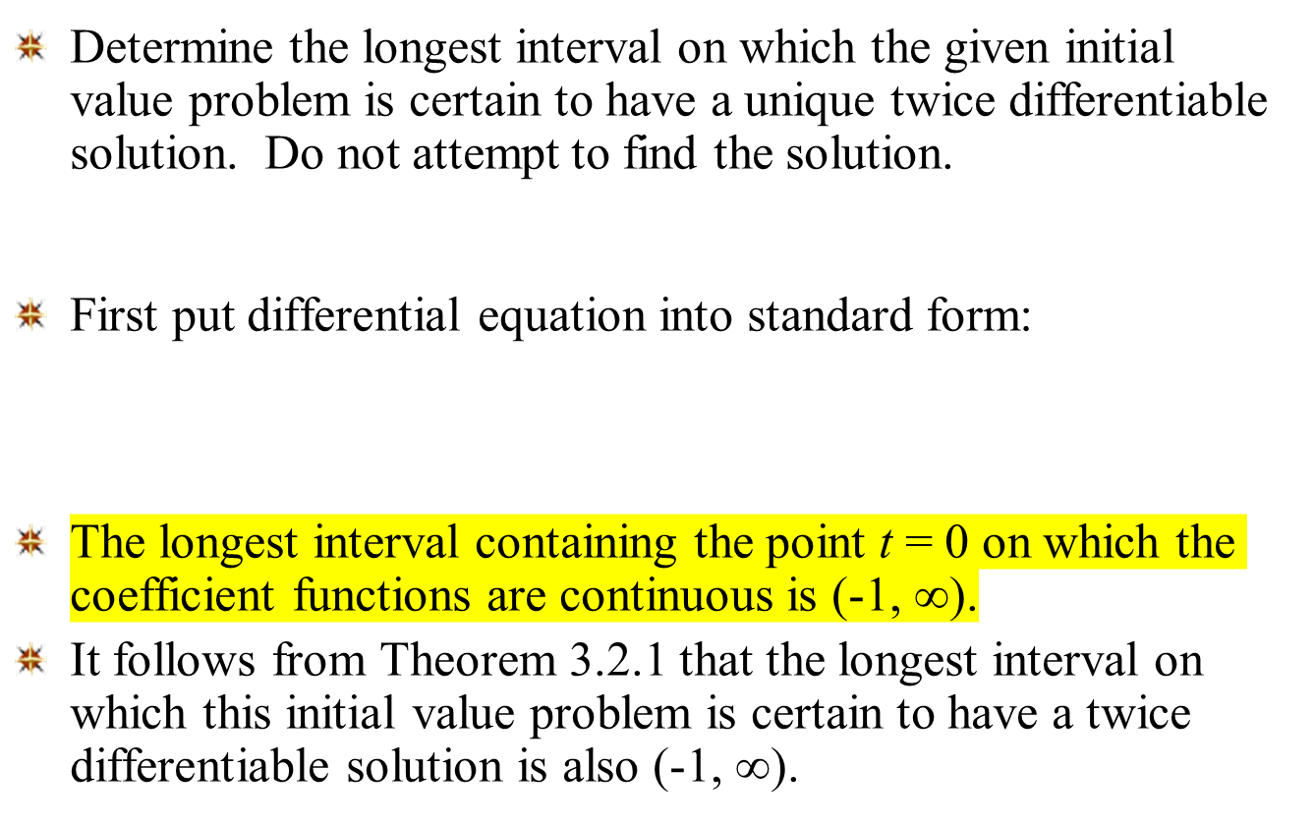
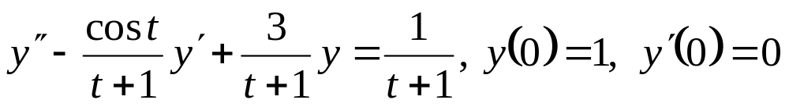
Example 3

Slide 7

Theorem 3.2.2 (Principle of Superposition)
If y₁and y₂ are solutions to the equation
then the linear combination c₁y₁ + y₂c₂ is also a solution, for all constants c₁ and c₂.
To prove this theorem, substitute c₁y₁ + y₂c₂ in for y in the equation above, and use the fact that y₁ and y₂ are solutions.
Thus for any two solutions y₁ and y₂, we can construct an infinite family of solutions, each of the form y = c₁y₁ + c₂ y₂.
Can all solutions be written this way, or do some solutions have a different form altogether? To answer this question, we use the Wronskian determinant.

Slide 8

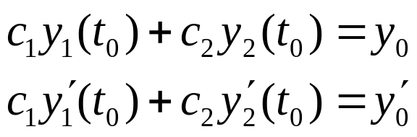
The Wronskian Determinant (1 of 3)
Suppose y₁ and y₂ are solutions to the equation
From Theorem 3.2.2, we know that y = c₁y₁ + c₂ y₂ is a solution to this equation.
Next, find coefficients such that y = c₁y₁ + c₂ y₂ satisfies the initial conditions
To do so, we need to solve the following equations:

Slide 9
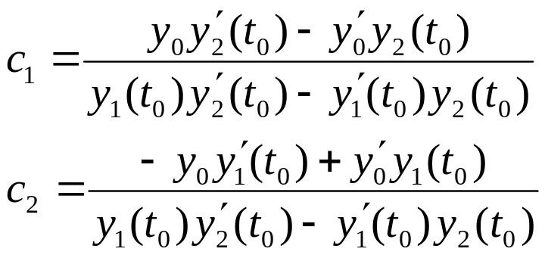
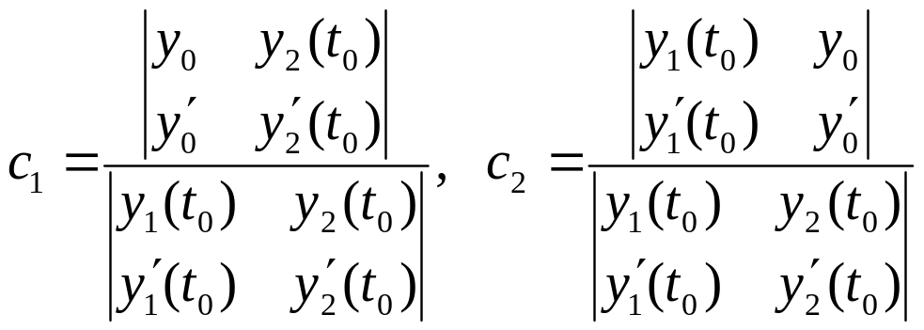
The Wronskian Determinant (2 of 3)
Solving the equations, we obtain
In terms of determinants:

Slide 10
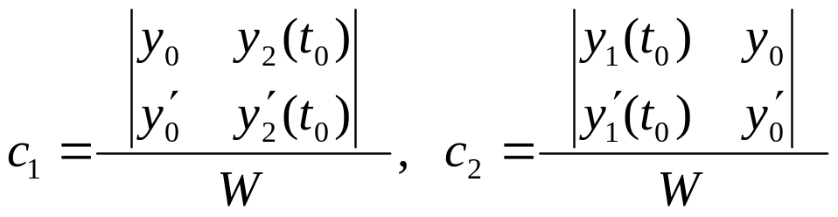
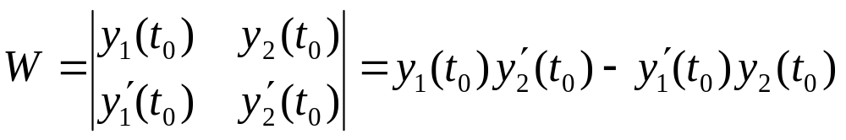

The Wronskian Determinant (3 of 3)
In order for these formulas to be valid, the determinant W in the denominator cannot be zero:
W is called the Wronskian determinant, or more simply, the Wronskian of the solutions y₁and y₂. We will sometimes use the notation

Slide 11


Theorem 3.2.3
Suppose y₁ and y₂ are solutions to the equation
and that the Wronskian
is not zero at the point t₀ where the initial conditions
are assigned. Then there is a choice of constants c₁, c₂ for which y = c₁y₁ + c₂ y₂ is a solution to the differential equation (1) and initial conditions (2).

Slide 12
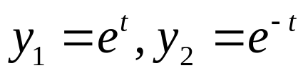
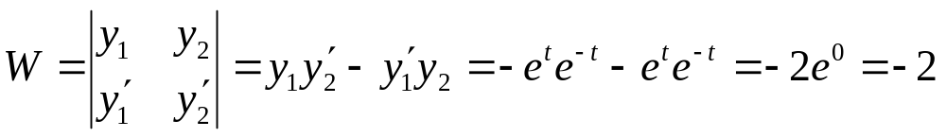

Example 4
Recall the following initial value problem and its solution:
Note that the two functions below are solutions to the differential equation:
The Wronskian of y₁ and y₂ is
Since W ≠ 0 for all t, linear combinations of y₁ and y₂ can be used to construct solutions of the IVP for any initial value t₀.

Slide 13

Theorem 3.2.4 (Fundamental Solutions)
Suppose y₁ and y₂ are solutions to the equation
If there is a point t₀ such that W(y₁,y₂)(t₀) ≠ 0, then the family of solutions y = c₁y₁ + c₂ y₂ with arbitrary coefficients c₁, c₂ includes every solution to the differential equation.
The expression y = c₁y₁ + c₂ y₂ is called the general solution of the differential equation above, and in this case y₁ and y₂ are said to form a fundamental set of solutions to the differential equation.

Slide 14

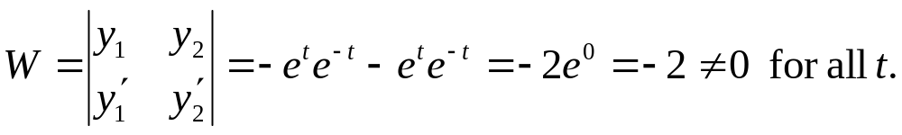

Example 5
Recall the equation below, with the two solutions indicated:
The Wronskian of y₁ and y₂ is
Thus y₁ and y₂ form a fundamental set of solutions to the differential equation above, and can be used to construct all of its solutions.
The general solution is

Slide 15

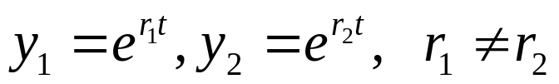
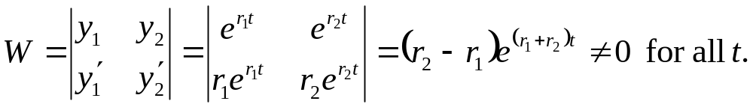
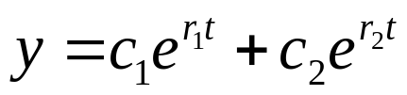
Example 6
Consider the general second order linear equation below, with the two solutions indicated:
Suppose the functions below are solutions to this equation:
The Wronskian of y₁and y₂ is
Thus y₁and y₂ form a fundamental set of solutions to the equation, and can be used to construct all of its solutions.
The general solution is

Slide 16


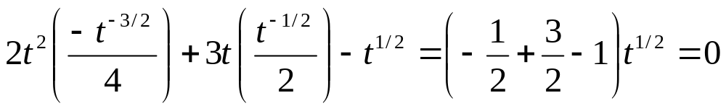
Example 7: Solutions (1 of 2)
Consider the following differential equation:
Show that the functions below are fundamental solutions:
To show this, first substitute y₁ into the equation:
Thus y₁ is a indeed a solution of the differential equation.
Similarly, y₂ is also a solution:

Slide 17
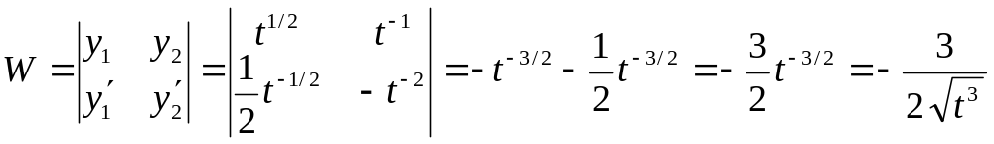
Example 7: Fundamental Solutions (2 of 2)
Recall that
To show that y₁ and y₂ form a fundamental set of solutions, we evaluate the Wronskian of y₁ and y₂:
Since W ≠ 0 for t > 0, y₁, y₂ form a fundamental set of solutions for the differential equation

Slide 18


Theorem 3.2.5: Existence of Fundamental Set of Solutions
Consider the differential equation below, whose coefficients p and q are continuous on some open interval I:
Let t₀ be a point in I, and y₁ and y₂ solutions of the equation with y₁ satisfying initial conditions
and y₂ satisfying initial conditions
Then y₁, y₂ form a fundamental set of solutions to the given differential equation.

Slide 19

Example 7: Theorem 3.2.5 (1 of 3)
Find the fundamental set specified by Theorem 3.2.5 for the differential equation and initial point
We showed previously that
were fundamental solutions, since W(y₁, y₂)(t₀) = -2 ≠ 0.
But these two solutions don’t satisfy the initial conditions stated in Theorem 3.2.5, and thus they do not form the fundamental set of solutions mentioned in that theorem.
Let y₃ and y₄ be the fundamental solutions of Thm 3.2.5.

Slide 20
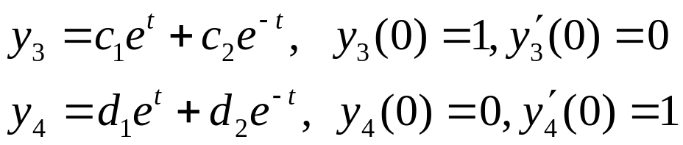
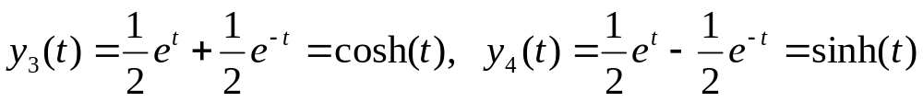
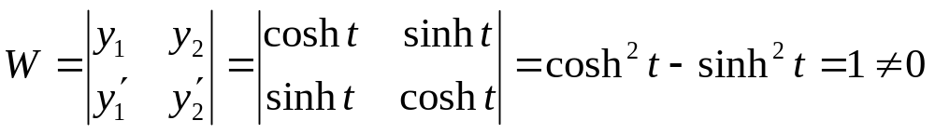

Example 7: General Solution (2 of 3)
Since y₁ and y₂ form a fundamental set of solutions, although not specified by Theorem 3.2.5
Solving each equation, we obtain
The Wronskian of y₃ and y₄ is
Thus y₃, y₄ forms the fundamental set of solutions indicated in Theorem 3.2.5, with general solution in this case

Slide 21

Example 7:
Many Fundamental Solution Sets (3 of 3)
Thus
both form fundamental solution sets to the differential equation and initial point
In general, a differential equation will have infinitely many different fundamental solution sets. Typically, we pick the one that is most convenient or useful.

Slide 22
Summary
To find a general solution of the differential equation
we first find two solutions y₁ and y₂.
Then make sure there is a point t₀ in the interval such that W(y₁, y₂)(t₀) ≠ 0.
It follows that y₁ and y₂ form a fundamental set of solutions to the equation, with general solution y = c₁y₁ + c₂ y₂.
If initial conditions are prescribed at a point t₀ in the interval where W ≠ 0, then c₁ and c₂ can be chosen to satisfy those conditions.

Slide 23

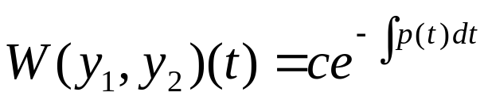
Theorem 3.2.6 (Abel’s Theorem)
Suppose y₁ and y₂ are solutions to the equation
where p and q are continuous on some open interval I. Then W(y₁,y₂)(t) is given by
where c is a constant that depends on y₁ and y₂ but not on t.
Note that W(y₁,y₂)(t) is either zero for all t in I (if c = 0) or else is never zero in I (if c ≠ 0).

Slide 24

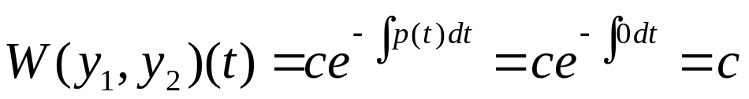
Example 8: Wronskian and Abel’s Theorem
Recall the following equation and two of its solutions:
The Wronskian of y₁and y₂ is
Thus y₁ and y₂ are linearly independent on any interval I, by Theorem 3.3.1. Now compare W with Abel’s Theorem:
Choosing c = -2, we get the same W as above.

